Slide 1
Excel Advanced
Session 5

Slide 2
Contents
Conditional Formatting
Protect Cells
Drop Down List
Remove Duplicate
Charts

Slide 3
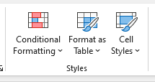
Conditional Formatting

Slide 4
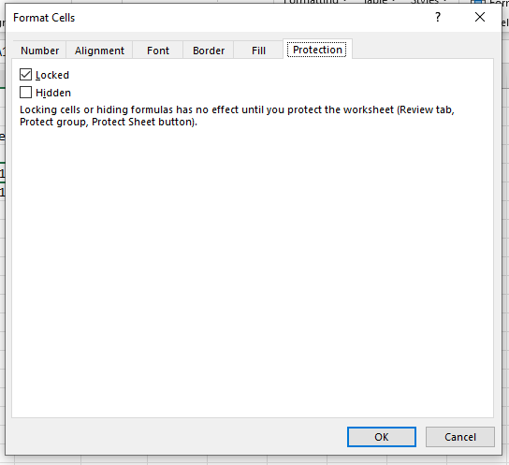
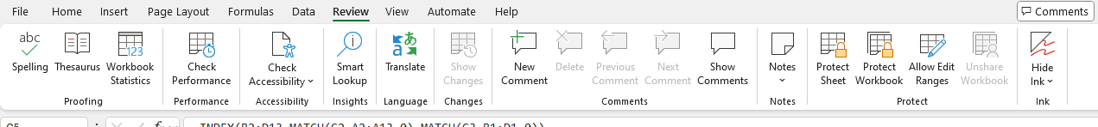
Protect Cells

Slide 5
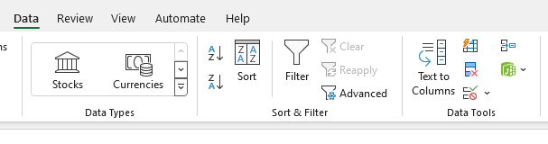
Date Validation
Drop Down List

Slide 6
Remove Duplicate
Advanced Filter
Show Duplicate from conditional formatting

Slide 7
Charts
Column
Bar
Line
Pie
Donut

Slide 8
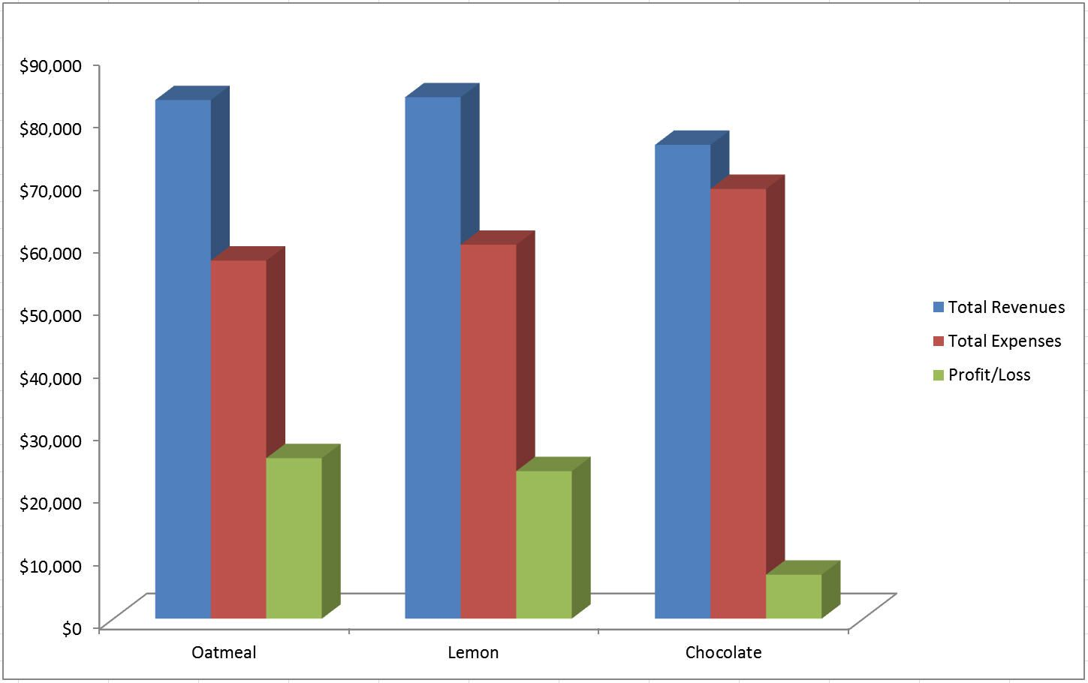
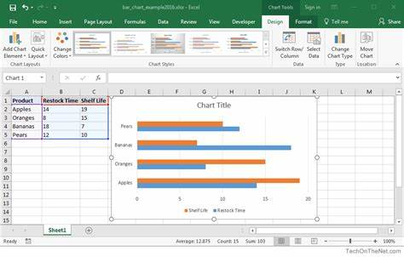
Charts (Column, Bar)

Slide 9
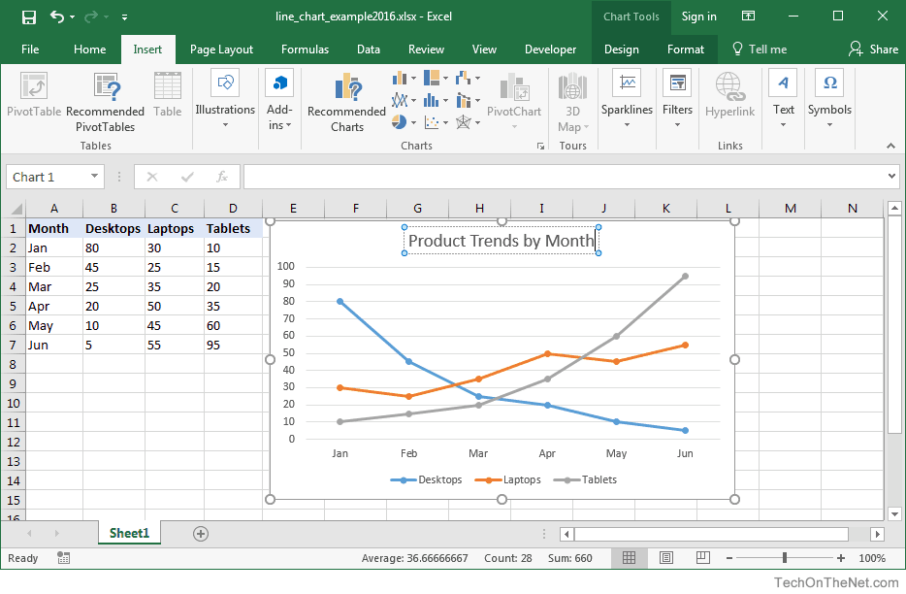
Charts (Line)

Slide 10
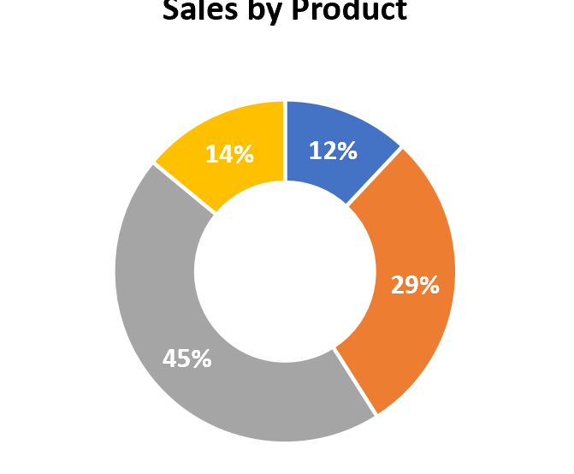
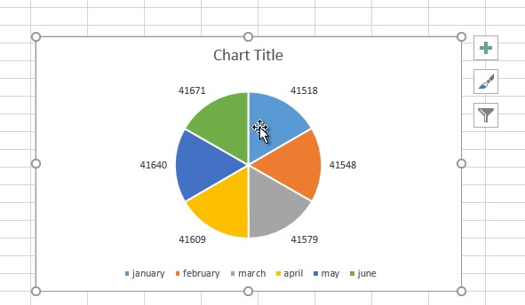
Charts (Pie, Doughnut)

Slide 11
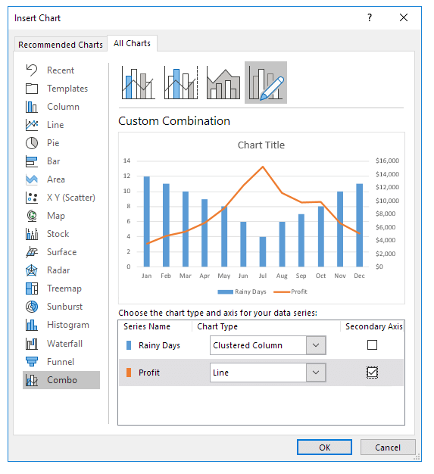
Combination Chart

Slide 12
Combination Chart

Slide 13
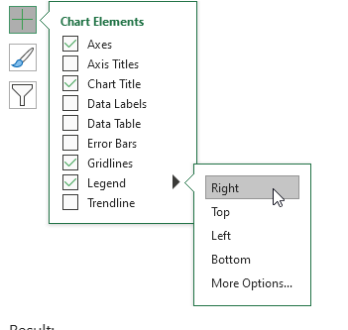
Chart Options
Axis Titles
Data Labels
Data Table
Gridlines
Legend

Slide 14
Thank you
Brain Station
Eng. Dalia Morad
Excel Advanced S5

